Slide 1
Ordering System
Bacyal, Grace Luzcelyn B.
Cabo, Ma. Joanna I.
Carlos, Rose Janeth G.
Gulane, Kristine P.
Mendio, Dianne F.

Slide 2
What the system does as a whole :
Present the Menu Tablet then
The Customer will Order and
Via GPRS the customer order will send to the kitchen monitor with the table number
Then waiting for the customer order
The monitor outside the kitchen will show that the food is ready to serve
Then automatically compute the bill
And print the Receipt.

Slide 3
Transaction Covered :
QUERIES :
Bill payments
Generates reports
Controlling user access authority to system resources
User ID
Order Item
Time and Date
Item Price
Table number

Slide 4
Reports :
Special Technologies :
Show the customer order
Time and Date
Total amount paid
Total sales per day
Tablet
Monitor
Printer

Slide 5
Major difference from other system :
We are using Tablet for ordering to show the menu and price. Using Tablet in ordering is a big advantage it helps to easily add and take orders, to lessen man power and also to eliminate human error.
The customer input orders directly into the tablet with communicates the customer order to the kitchen food and drink order data entry display running total of purchase on screen then directly the order in the system to be fasted the work using of a tablet.
When the new orders come in, some general information about the new order will be inputted such as item from the menu, the price of each item, table number, time and date.

Slide 6
INTEGRATION WITH OTHER SYSTEM PRESENTED VIA DIAGRAM
ORDERING
POS

Slide 7
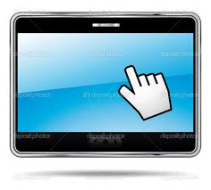
SOLUTION ARCHITECTURE
Staff
Manager
Customer
Restaurant Ordering System (Customer end) GUI interface
Restaurant Ordering System (Staff end) GUI interface
Restaurant Ordering System (Manager end) GUI interface
Customer Relational Database
System Database

Slide 8
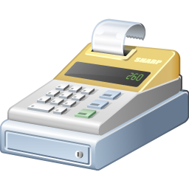
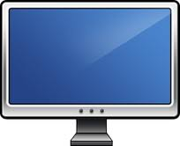
SYSTEM LAYOUT
(Staff)
(Customer)
Order
Menu Tablet
Print Receipt
Send to Kitchen
Compute Bill
Ready to serve
Waiting the order

Slide 9
WORKFLOW
Log in to the system
Present the tablet to the customer
The customer will choose their order to the tablet
Customer order will send to the kitchen monitor
Waiting to the customer order
Log out
The monitor outside the kitchen show that the customer order will ready to serve
Print Receipt
Compute the total bill

Slide 10
TIMELINE
Chapter 3.2 Designing Database Coding for the System Doing Chapter 4 Doing Chapter 5 Doing Chapter 6 Revising of Documents Testing of System Maintenance for the System Completing the Documents and System Final Defense | November | December | January | February | March

